Slide 1
Network Science Overview
Sagar Samtani, Weifeng Li, Hsinchun Chen
Spring 2016
Acknowledgements: Dr. C. Lee Giles, Pennsylvania State University; Dr. Mark Newman, University of Michigan; Dr. Christopher McCarty, University of Florida; Dr. Huan Liu, Arizona State University; Dr. Sudha Ram, University of Arizona; Dr. Jon Kleinberg, Cornell University; Rob Cross, University of Virginia

Slide 2
Outline
Introduction
Network Terminology
Network Metrics
Node Level
Network Level
Network Models
ER Random Graph
Scale-free Network
Small World Network
The Web as a Network
Hubs and Authorities
HITS
PageRank
Network Diffusion: the SIR Model
Network Visualization Tools and Capabilities
Selected Open Source Visualization Tools
UCINET/NetDraw Example
Pajek Example

Slide 3
Introduction
A network is a collection of entities that are interconnected with links.
Network science is based on graph theory.
Also influenced by social sciences, economics, statistics, computer science.
These slides summarize basic network science terms, concepts, and models.

Slide 4
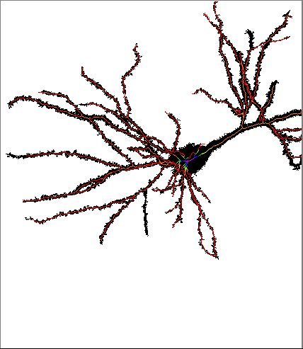
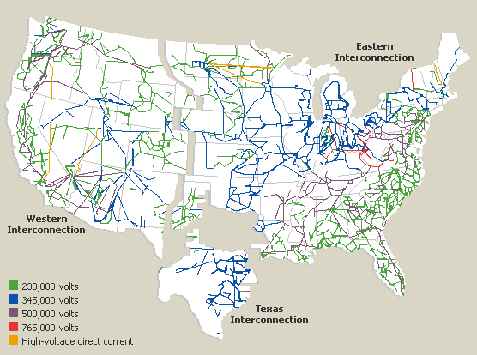
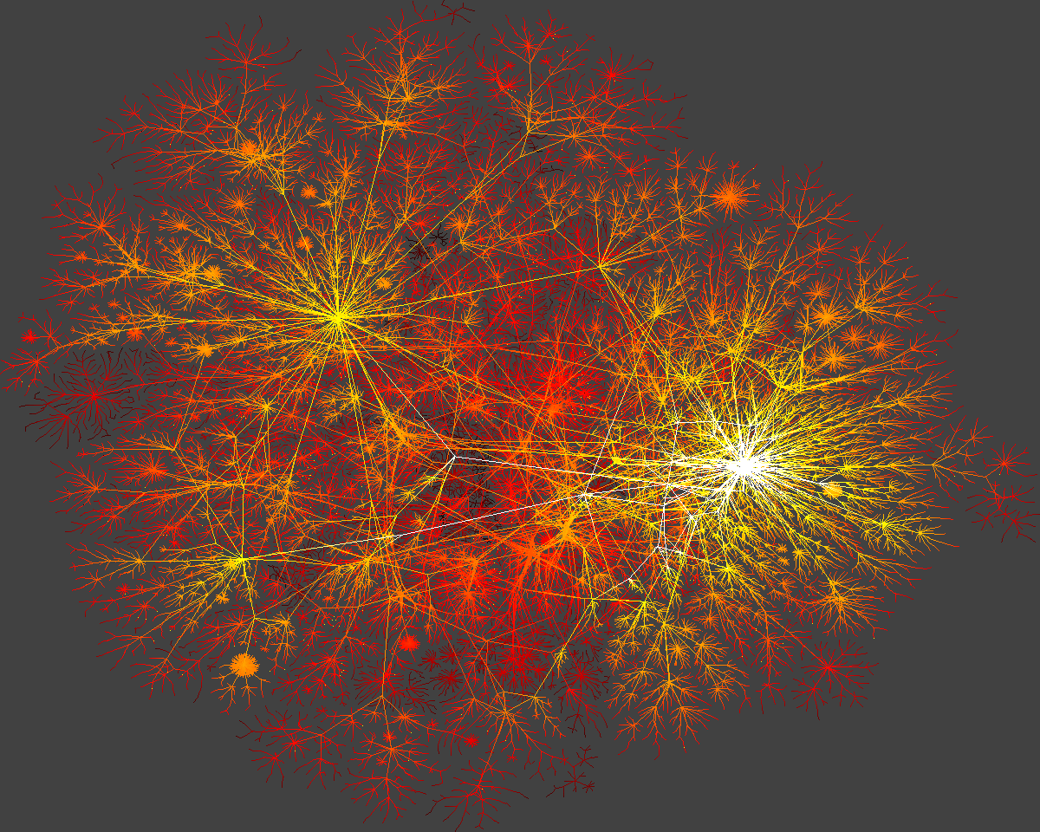
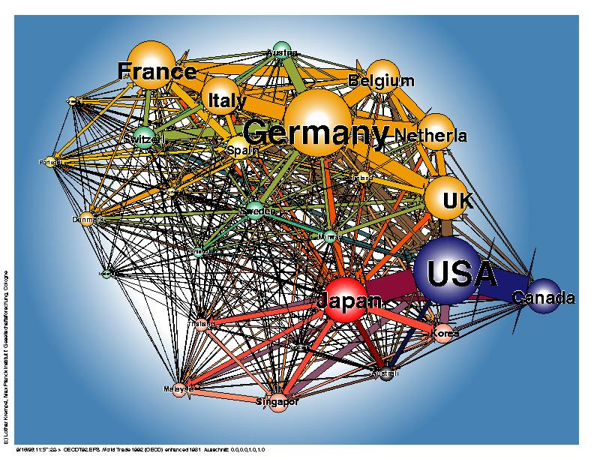
Introduction – Examples of Networks
Networks are used for a variety of purposes, including:
People that are friends
Interconnected computers
Web pages pointing to each other
Interacting proteins
Other examples are depicted on the right.
The Human Brain
North American Power Grid
Foreign Exchange
Map of Internet

Slide 5
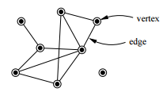
Network Terminology
Networks are built with two fundamental building blocks: node and edges.
A node represents the entity of interest.
An edge is a connection between entities.
Can be directed (one-way) or undirected (mutual) relationships
Nodes and edges can be manipulated based on the context to create different types of networks.
Discipline | Points | Lines
Math | Vertices | Edges, arcs
Computer Science | Nodes | Links
Physics | Sites | Bonds
Sociology | Actors | Ties, relations

Slide 6
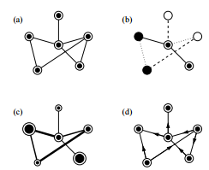
Various Network Configurations
Regardless of network type, the nodes and edges from the network can calculate useful network and node level measures.
Examples of various types of network configurations include:
An undirected network with only a single type of node and edge
A network with a number of discrete node and edge types
A network with varying node and edge weights
A directed network in which each edge has a direction

Slide 7
Outline
Introduction
Network Terminology
Network Metrics
Node Level
Network Level
Network Models
ER Random Graph
Scale-free Network
Small World Network
The Web as a Network
Hubs and Authorities
HITS
PageRank
Network Diffusion: the SIR Model
Network Visualization Tools and Capabilities
Selected Open Source Visualization Tools
UCINET/NetDraw Example
Pajek Example

Slide 8
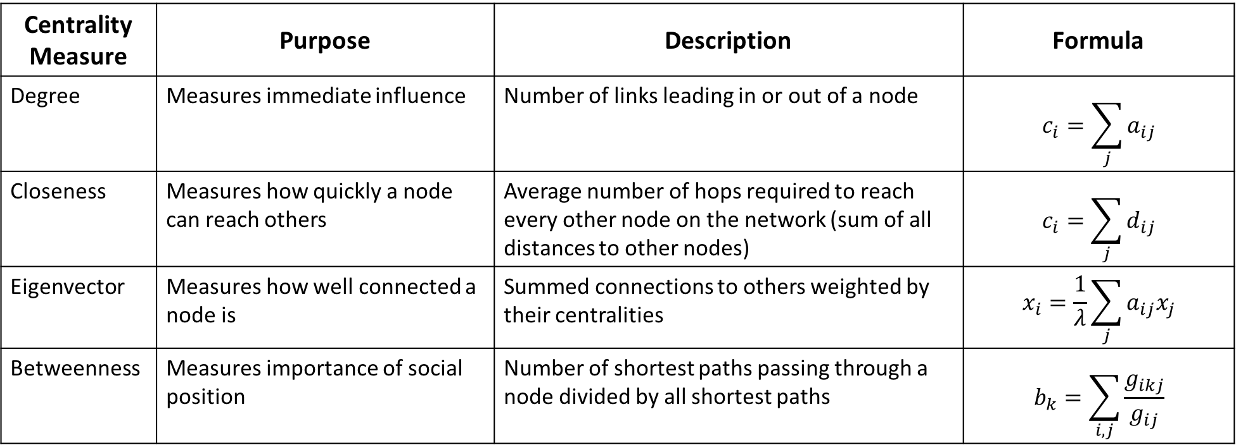
Network Metrics – Node Level
Four standard centrality measures (summarized below) can identify a nodes’ importance with a network.
Centrality Measure | Purpose | Description | Formula
Degree | Measures immediate influence | Number of links leading in or out of a node | $$c_{i}=\sum_{j}{a_{ij}}$$
Closeness | Measures how quickly a node can reach others | Average number of hops required to reach every other node on the network (sum of all distances to other nodes) | $$c_{i}=\sum_{j}{d_{ij}}$$
Eigenvector | Measures how well connected a node is | Summed connections to others weighted by their centralities | $$x_{i}=\frac{1}{λ}\sum_{j}{a_{ij}x_{j}}$$
Betweenness | Measures importance of social position | Number of shortest paths passing through a node divided by all shortest paths | $$b_{k}=\sum_{i, j}{\frac{g_{ikj}}{g_{ij}}}$$

Slide 9
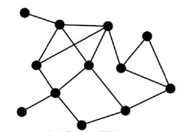
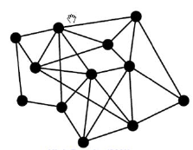
Network Metrics – Network Level
Network level metrics can understand the overall nature of the network.
Some of the most basic measures include:
Network Size – measuring how many nodes are in the network
Density – sum of edges divided by number of possible edges. Gives insight to how quickly information diffuses among the nodes.
Size – 12; Density – 25%
Size – 12; Density – 39%

Slide 10
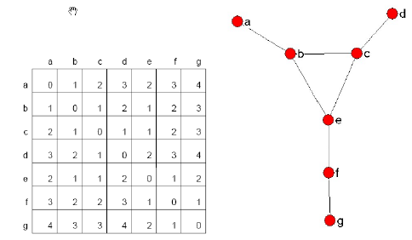
Network Metrics – Length and Distance
The length of a path is the number of links between two nodes.
The distance between two nodes is the length of the shortest path (i.e., geodesic).
Can also calculate average distances between two nodes.
Matrix with calculated geodesic distances
for each node combination

Slide 11
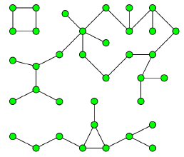
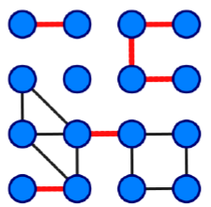
Network Metrics – Connected Components and Bridges
A connected component of an undirected network is a subgraph in which any two nodes are connected to each other by paths, and which is connected to no additional nodes in the network.
A bridge is an edge whose deletion increases the number of connected components.
Network with 3 connected components
Red edges signify bridges

Slide 12
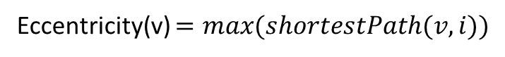
Network Metrics – Eccentricity, Diameter, Radius
The eccentricity of a node v is the maximum geodesic distance from v to all other nodes in graph G.
The diameter of a network is the maximum eccentricity.
The radius of a network is the minimum eccentricity.
Eccentricity(v) $=max(shortestPath(v,i))$

Slide 13
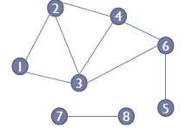
Network Metrics – Dyads and Cliques
Identifying subgroups can also be very useful in some networks.
A dyad is a pairing of two nodes.
A clique is a set of three or more nodes.
{7,8} is a dyad, and {1,2,3} is a clique

Slide 14
Outline
Introduction
Network Terminology
Network Metrics
Node Level
Network Level
Network Models
ER Random Graph
Scale-free Network
Small World Network
The Web as a Network
Hubs and Authorities
HITS
PageRank
Network Diffusion: the SIR Model
Network Visualization Tools and Capabilities
Selected Open Source Visualization Tools
UCINET/NetDraw Example
Pajek Example

Slide 15
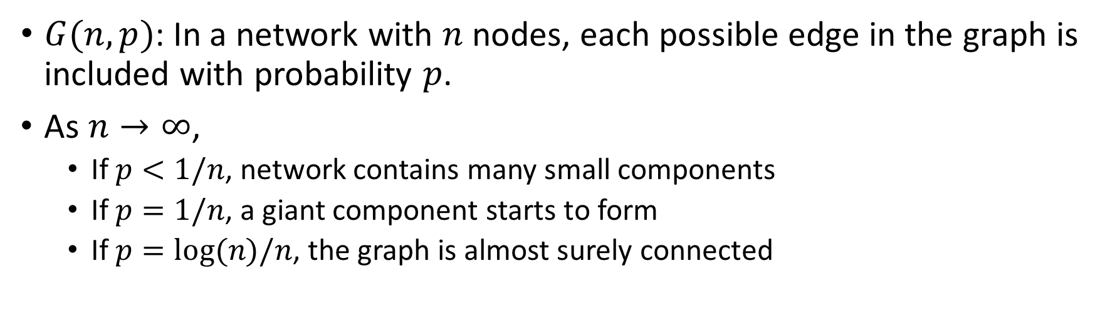
Network Models: Erdos-Renyi Random Graph
$G(n,p)$: In a network with $n$ nodes, each possible edge in the graph is included with probability $p$.
As $n→∞$,
If $p<1/n$, network contains many small components
If $p=1/n$, a giant component starts to form
If $p=log⁡(n)/n$, the graph is almost surely connected
A graph generated by the binomial model of Erdős and Rényi (p = 0.01)

Slide 16
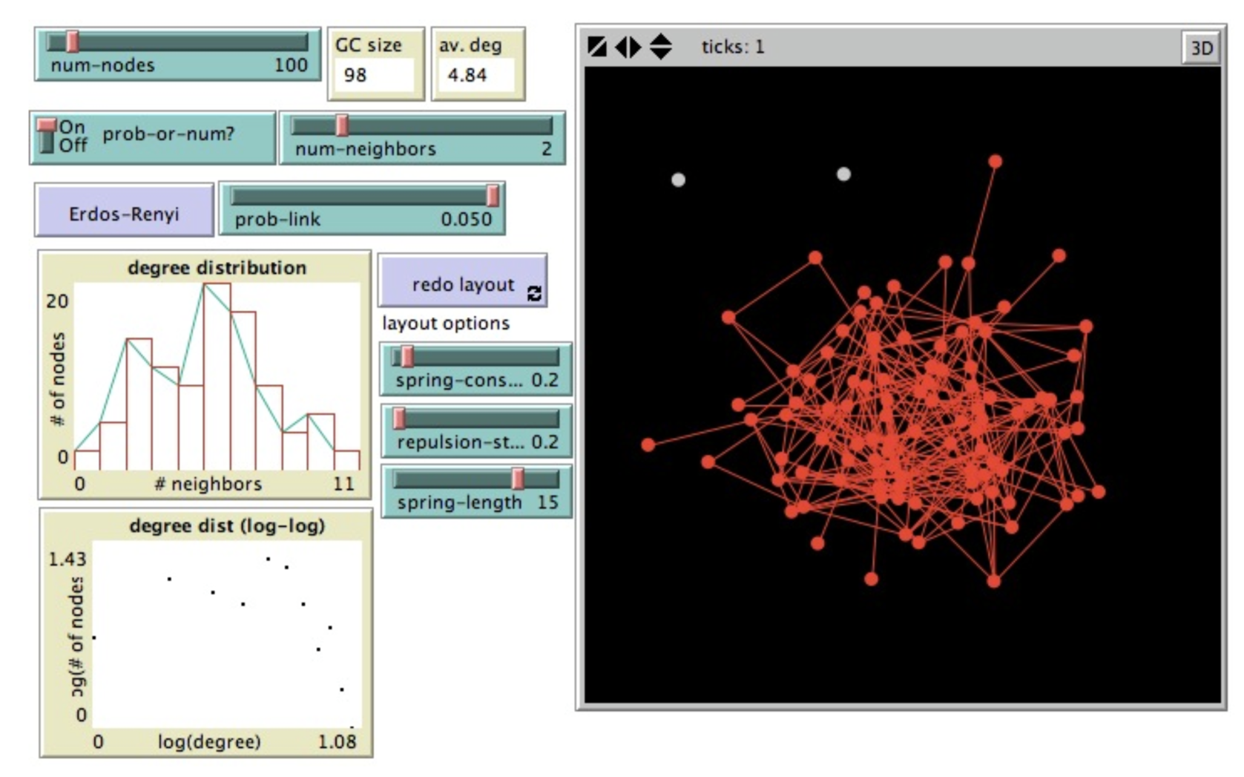
Erdos-Renyi Random Graph Example
Source: http://www.ladamic.com/netlearn/nw/RandomGraphs.html

Slide 17
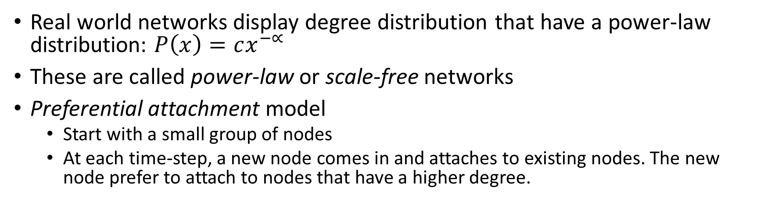
Network Models: Scale-free Network
Real world networks display degree distribution that have a power-law distribution: $P\left(x\right)=cx^{−∝}$
These are called power-law or scale-free networks
Preferential attachment model
Start with a small group of nodes
At each time-step, a new node comes in and attaches to existing nodes. The new node prefer to attach to nodes that have a higher degree.

Slide 18
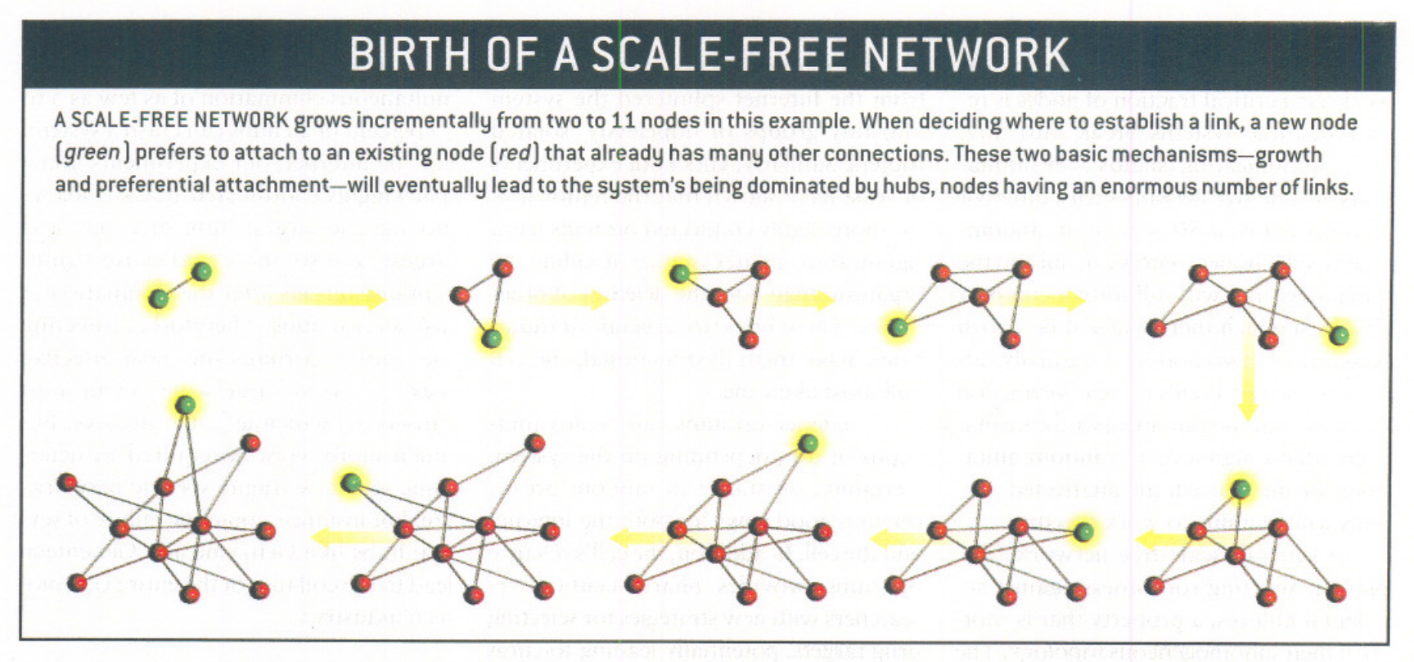
Scale-free Network Example

Slide 19
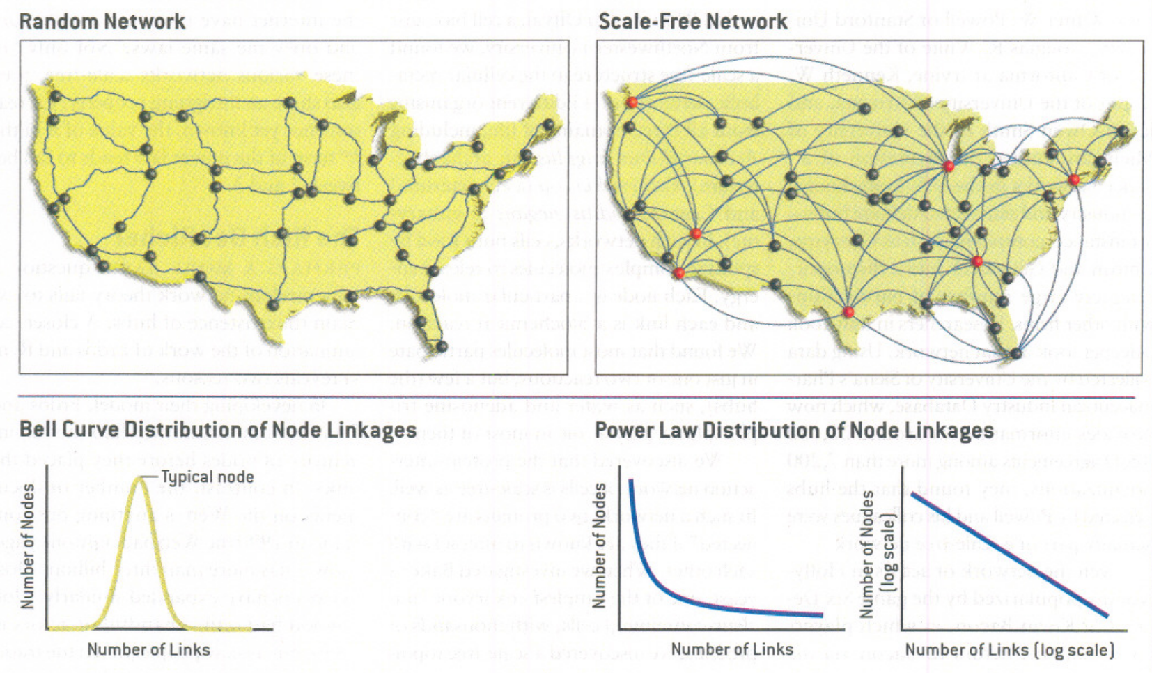
Scale-free Network vs Random Graph

Slide 20
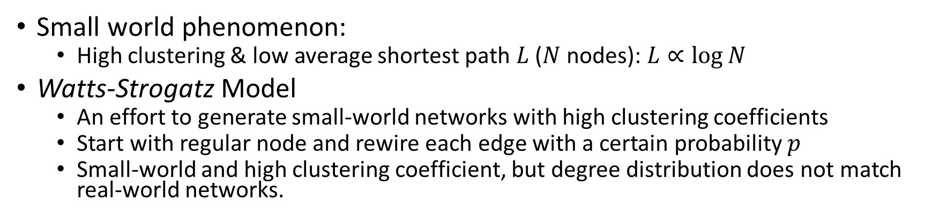
Network Models: Small World Network
Small world phenomenon:
High clustering & low average shortest path $L$ ($N$ nodes): $L∝\log{N}$
Watts-Strogatz Model
An effort to generate small-world networks with high clustering coefficients
Start with regular node and rewire each edge with a certain probability $p$
Small-world and high clustering coefficient, but degree distribution does not match real-world networks.
Small-world Network Example

Slide 21
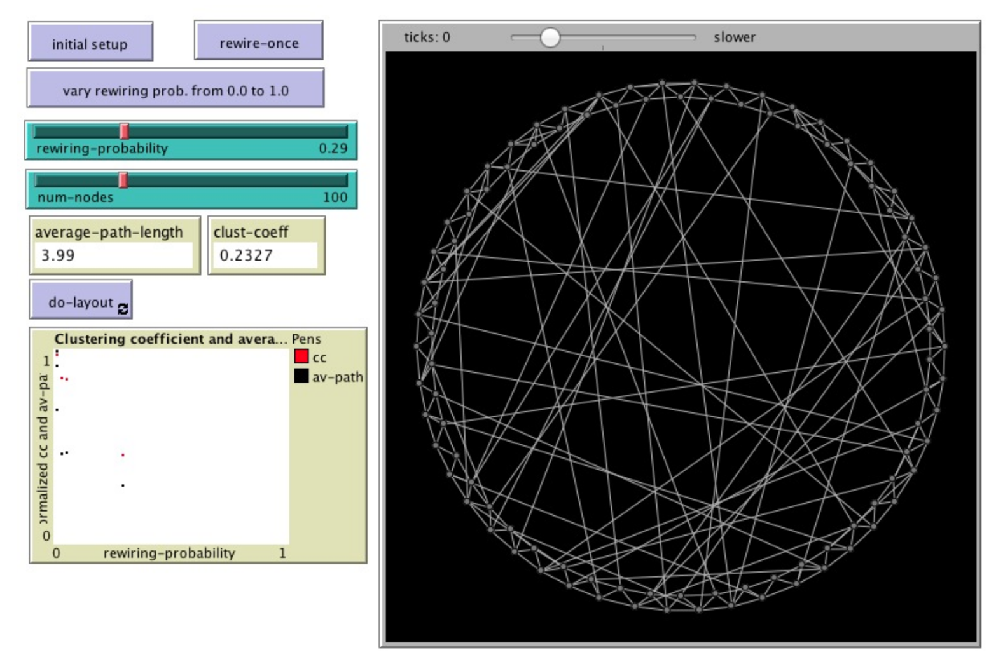
Small World Network Example
Source: http://www.ladamic.com/netlearn/NetLogo4/SmallWorldWS.html

Slide 22
Outline
Introduction
Network Terminology
Network Metrics
Node Level
Network Level
Network Models
ER Random Graph
Scale-free Network
Small World Network
The Web as a Network
Hubs and Authorities
HITS
PageRank
Network Diffusion: the SIR Model
Network Visualization Tools and Capabilities
Selected Open Source Visualization Tools
UCINET/NetDraw Example
Pajek Example

Slide 23
The Web as a Network
One of the most popular networks today is the web.
In this network, each web page is a node, and each of the hyperlinks between pages are edges.
This representation has led to an area of network science called link analysis.
Link analysis is often used to guide various web related activities including crawling, ranking, etc.

Slide 24
The Web as a Network – Authorities and Hubs
Two of the most basic (yet critical and valuable) concepts in link analysis are authorities and hubs.
Authorities are web pages that are authoritative sources of information (e.g., medical research institute, newspaper home pages etc.).
Hubs are index pages that provide many useful links to relevant content pages or authorities (e.g., list of newspapers, course bulletin etc.).
Generally, good hubs point to many good authorities, and good authorities are pointed by many hubs.

Slide 25
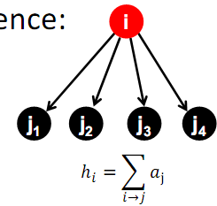
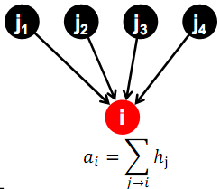
The Web as a Network – Authorities and Hubs
Each page p, has two scores:
A hub score (h) quality as an expert
An authority score (a) quality as content
Authority Update Rule: For each page i, update a(i) to be the sum of the hub scores of all pages that point to it.
Hub Update Rule: For each page i, update h(i) to be the sum of the authority scores of all pages that it points to.
Certain algorithms such as Hypertext Induced Topic Search (HITS) are used to assign and update scores for each hub and authority page.

Slide 26
The Web as a Network – HITS
Start with all hub scores and all authority scores equal to 1.
Choose a number of steps k.
Perform a sequence of k hub-authority updates. For each node:
First, apply the Authority Update Rule to the current set of scores.
Then, apply the Hub Update Rule to the resulting set of scores.
At the end, hub and authority scores may be very large.
Normalize: divide each authority score by the sum of all authority scores, and each hub score by the sum of all hub scores.

Slide 27
The Web as a Network – PageRank
PageRank is a link analysis algorithm popularized by Google designed to accurately represent a webpages’ true importance.
Just measuring the in-links does not account for the authority or reputability of the source of a link.
Search results could be skewed, as not all links are equally important.
PageRank assigns a numerical weighting to each webpage based on the number of in-links, out-links, and the quality of those links.
Defined recursively.

Slide 28
The Web as a Network – PageRank Algorithm
Let S be the total set of pages.
Let ∀p∈S: E(p) = α/|S| (for some 0<α<1, e.g. 0.15)
Initialize ∀p∈S: R(p) = 1/|S|
Until ranks do not change (much) (convergence)
For each p∈S:
For each p∈S: R(p) = cR´(p) (normalize)

Slide 29
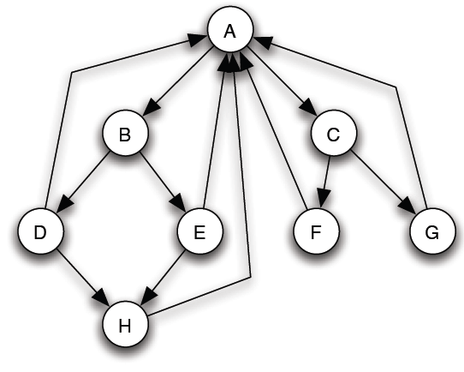
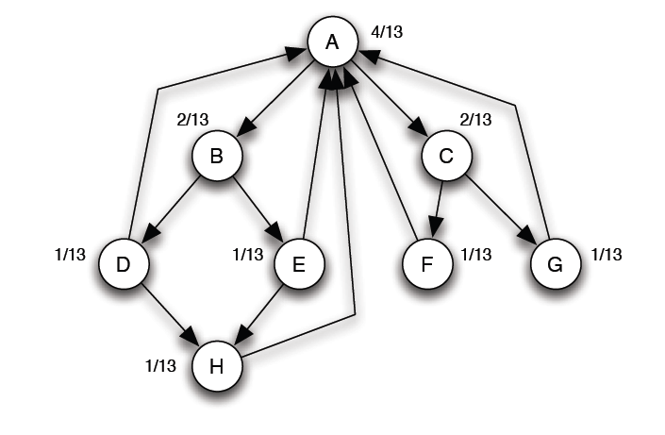
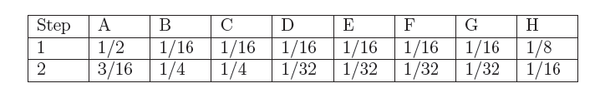
The Web as a Network – PageRank Example
After PageRank, all of the nodes are assigned their own rankings.
An update to one node could change ranks for many others.
Initially, all nodes receive an equal ranking

Slide 30
The Web as a Network – PageRank Extensions
PageRank has had a variety of extensions, including:
Random Walks, dealing with users who randomly browse web pages
Dead ends, dealing with some pages who have no out-links
Spider traps, where all out-links are within the group
Google has added in their own flavor into the core PageRank algorithm by considering additional factors such as:
Analyzing anchor text in HTML pages
Factoring in user feedback (click or not on a result)
Attempts of web pages to score highly in search engine rankings

Slide 31
Outline
Introduction
Network Terminology
Network Metrics
Node Level
Network Level
Network Models
ER Random Graph
Scale-free Network
Small World Network
The Web as a Network
Hubs and Authorities
HITS
PageRank
Network Diffusion: the SIR Model
Network Visualization Tools and Capabilities
Selected Open Source Visualization Tools
UCINET/NetDraw Example
Pajek Example

Slide 32
Network Diffusion
Network diffusion captures the underlying mechanism of how the event/information propagates throughout a social network.
Answer to many important questions:
How fast will the event/information spread?
How will the social network affected by the propagation?
What is the best strategy to propagate through the network?
What is the best strategy to impede the propagation?
Etc.
As network diffusion process resembles disease spreading process, epidemiological models have been adopted to model network diffusion.

Slide 33
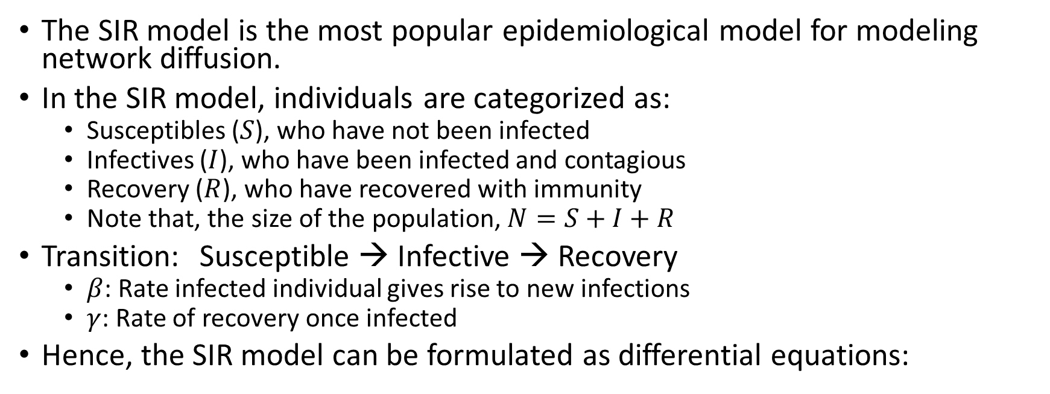
Network Diffusion: the SIR Model
The SIR model is the most popular epidemiological model for modeling network diffusion.
In the SIR model, individuals are categorized as:
Susceptibles ($S$), who have not been infected
Infectives ($I$), who have been infected and contagious
Recovery ($R$), who have recovered with immunity
Note that, the size of the population, $N=S+I+R$
Transition: Susceptible → Infective → Recovery
$β$: Rate infected individual gives rise to new infections
$γ$: Rate of recovery once infected
Hence, the SIR model can be formulated as differential equations:
Rate at which susceptible individuals encounter infected individuals and become infected
Rate at which infected individuals recover from the infected class

Slide 34
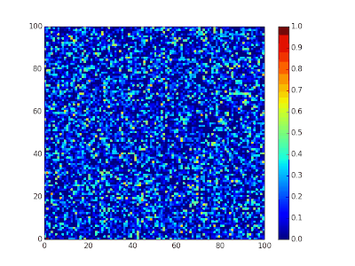
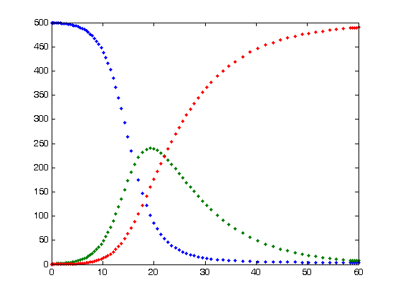
Illustration: the SIR Model
Number of people
Time
Spatial SIR model simulation. Each cell can infect its eight immediate neighbors.
Blue=Susceptible, Green=Infected, and Red=Recovered

Slide 35
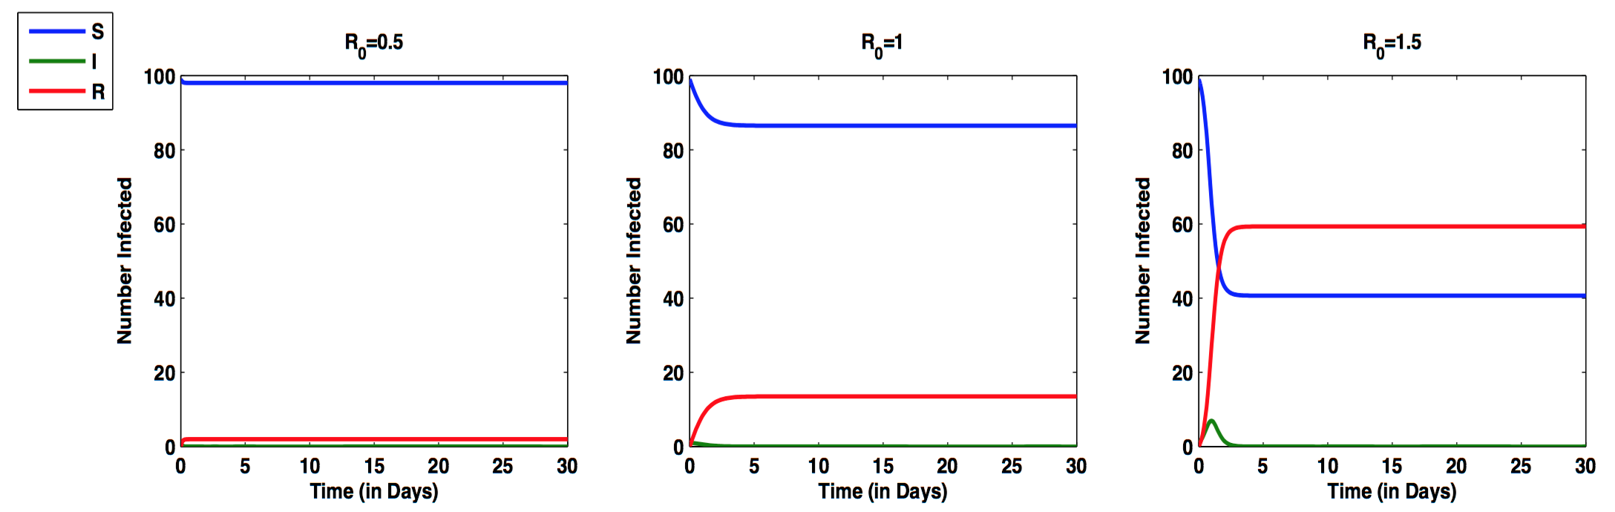
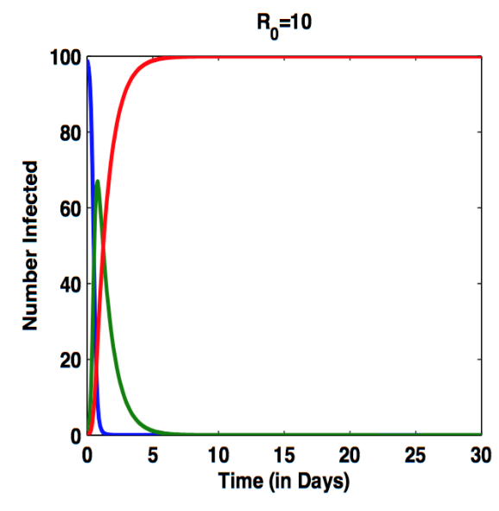
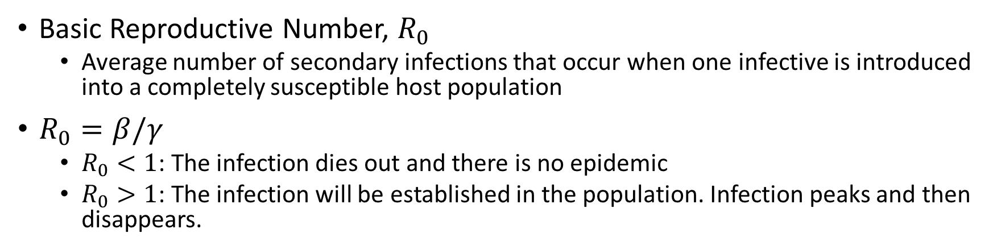
Network Diffusion: the SIR Model
Basic Reproductive Number, $R_{0}$
Average number of secondary infections that occur when one infective is introduced into a completely susceptible host population
$R_{0}=β/γ$
$R_{0}<1$: The infection dies out and there is no epidemic
$R_{0}>1$: The infection will be established in the population. Infection peaks and then disappears.

Slide 36
Outline
Introduction
Network Terminology
Network Metrics
Node Level
Network Level
Network Models
ER Random Graph
Scale-free Network
Small World Network
The Web as a Network
Hubs and Authorities
HITS
PageRank
Network Diffusion: the SIR Model
Network Visualization Tools and Capabilities
Selected Open Source Visualization Tools
UCINET/NetDraw Example
Pajek Example

Slide 37
Network Visualization Tools
There are a variety of free, network analysis tools available to create network visualizations and to calculate network measures.
Some of the more popular open source tools are summarized on the following slide.
Several samples of network tools (UCINET/NetDraw, Pajek) are provided in the subsequent slides.

Slide 38
Selected Open Source Network Visualization Tools
Tool | Main Functionality | Input format | Output format | Notes
Hashkat | Agent based simulation of online social networks | Import from plaintext | Output to Gephi, NetworkX | Dynamic network simulation tool designed to model the growth of and information propagation within an online social network. Uses kinetic Monte Carlo methods to simulate networks
Gephi | Interactive graph exploration and manipulation tool | .dot, .gml, .gdf, .graphml, .net, .dl, .csv, various databases | .gdf, .gexf, .svg, .png | Interactive, supports community detection, centrality calculations, various models, connectivity to DBs
GraphStream | Dynamic Graph Library | .dgs, .dot, .gml, edge lists | .dgs, .dot, .gml, image sequence | Deals with static and dynamic graphs. Provides basic measures.
NodeXL | Network overview, discovery, and exploration | CSV, TXT, XLS, .net, .dl, GraphML | CSV, TXT, XLS, .net, .dl, GraphML | Integrates with Excel. Supports extracting networks and providing basic measures/visualizations from Twitter, YouTube, Facebook, etc.
NetworkX | Python package | GML, GraphML, .dot, .yaml, .net, LEDA | GML, Gnome Dia, GraphML, .dot, .yaml, .net, assorted image formats | Standard centrality measures. Visualization is provided through pylab and graphviz
UCINET | Social network analysis and visualization | DL, Excel, VNA, Pajek, Text | DL, Excel, Pajek, Mage, Metis, VNA from Netdraw | Integrates NetDraw and Pajek. Methods include centrality measures, subgroup identification, role analysis, elementary Graph Theory, and permutation-based statistical analysis
Source: https://en.wikipedia.org/wiki/Social_network_analysis_software

Slide 39
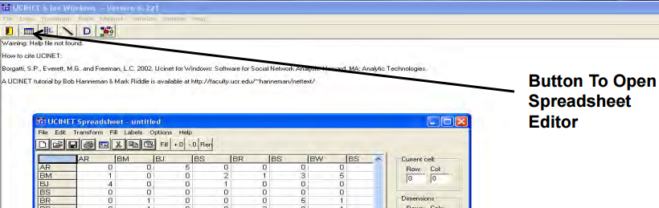
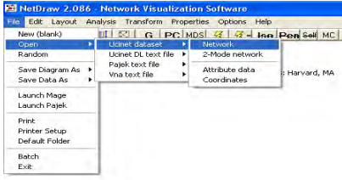
UCINET – Loading Data from Excel
Step 1. Copy data from Excel
Step 2. Open spreadsheet editor in UCINET
Step 3. Paste into spreadsheet editor in UCINET
Step 4. Save as “info”
Step 5. after loading data, navigate to File> Open> Network
Step 6. Choose network dataset (info.##h)

Slide 40
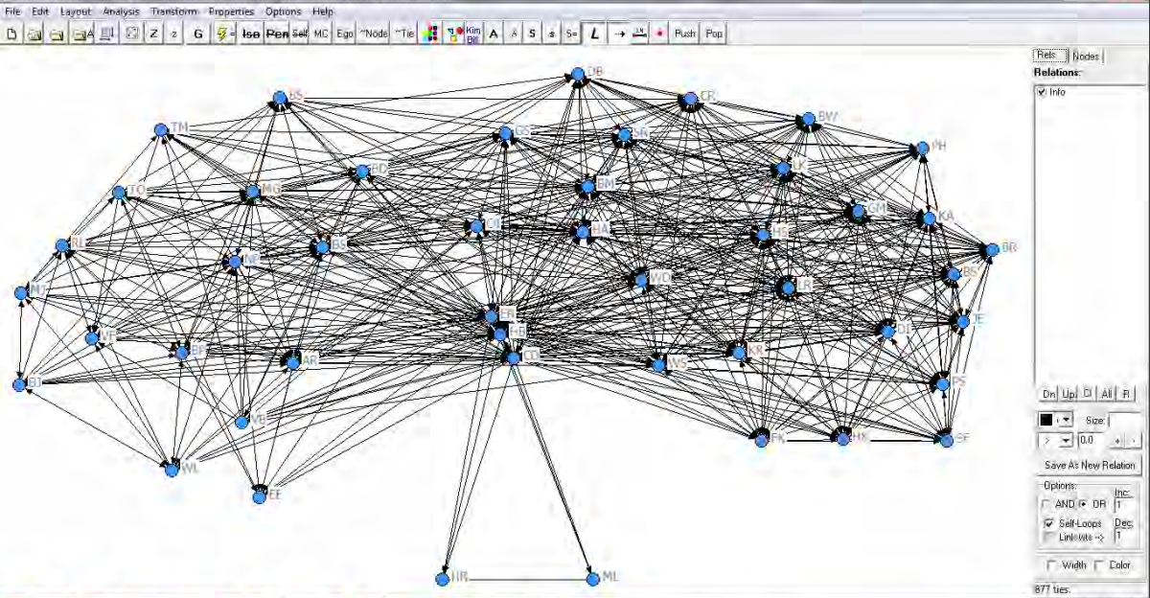
UCINET – Visualizing the Data
Different functions
Display setup of the nodes and relations
The networks: nodes representing the individuals and links representing
the relations

Slide 41
Pajek: Introduction
Pajek – (pronounced in Slovenian as Pah-yek) means ‘spider’
website: http://vlado.fmf.uni-lj.si/pub/networks/pajek/
wiki: http://pajek.imfm.si/doku.php
Helpful book: ‘Exploratory Social Network Analysis with Pajek’ by Wouter de Nooy, Andrej Mrvar and Vladimir Batagelj

Slide 42
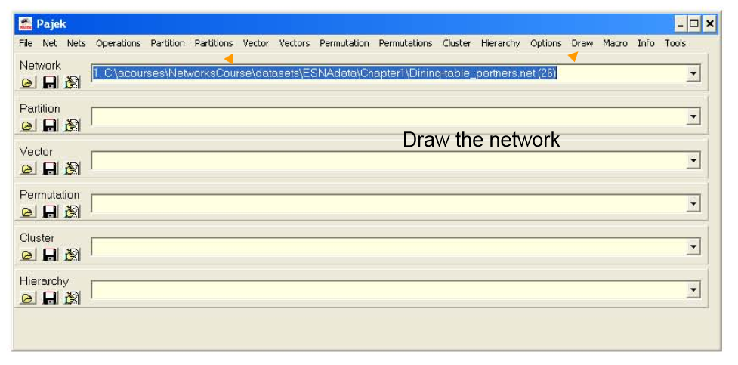
Pajek: Open and Visualize Networks
Open it in Pajek by either clicking on the yellow folder icon under the word "Network" or by selecting File>Network>Read from the main menu panel
Visualize the network using Pajek's Draw>Draw command from the main menu panel.
2
1

Slide 43
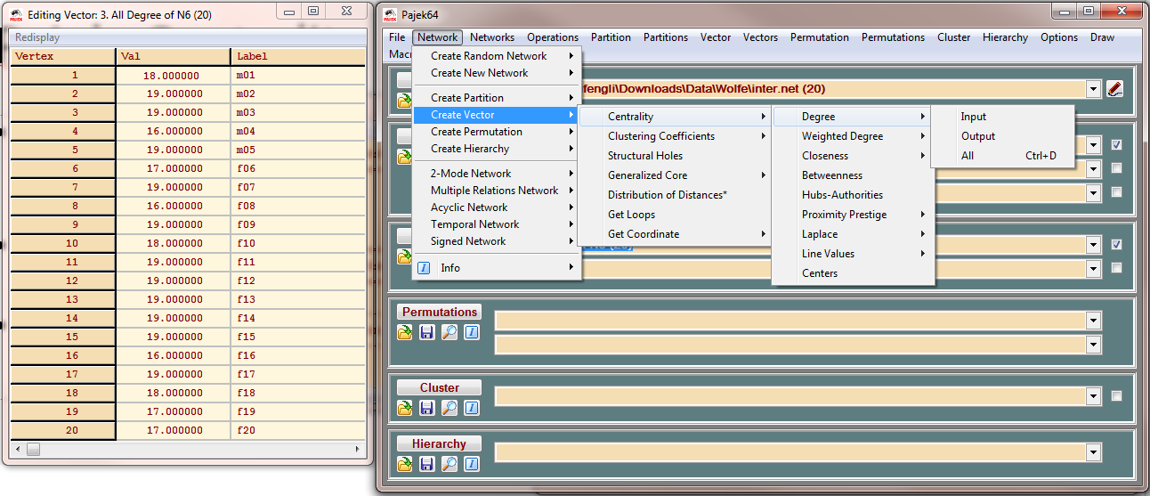
Pajek: Centrality Calculation
Degree
Calculation: Network > Create Vector > Centrality > Degree
Betweenness
Network > Create Vector > Centrality > Betweenness
Closeness
Network > Create Vector > Centrality > Closeness

Slide 44
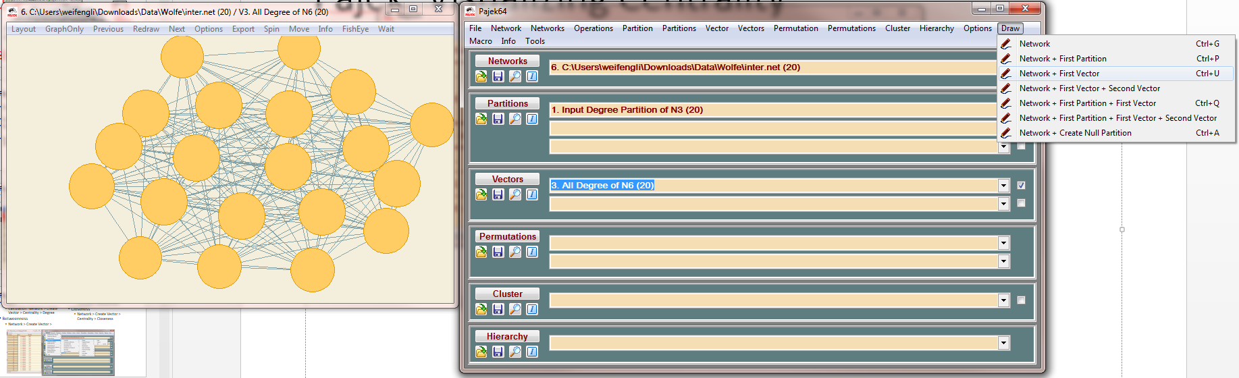
Pajek: Visualizing Centrality
Set the degree centrality as the first vector
Draw > Network + First Vector

